Slide 1
Datasets on deprivation from the UK Data Service
Alle Bloom, UK Data Service, University of Manchester

Slide 2

What is the UK Data Service?
What data are available?
Case studies
How to find and access this data
Copyright © 2023 UK Data Service. Created by UK Data Service, University of Manchester
Notes:
Hello everyone, I’m Alle Bloom from the UK Data Service User support and training team, based in Manchester and today I’m going to talk to you about some datasets available from the UKDS that could be used to explore various aspects of deprivation.

Slide 3
What is the UK Data Service?
a comprehensive resource funded by the ESRC
a single point of access to a wide range of secondary social science data
support, training and guidance
Notes:
So the UKDS is a comprehensive resource funded by the ESRC and we provide access to the largest collection of social, economic and population data in the UK.
Data providers deposit their data with us and then we make this available to users.
As well as this, in the training team we provide support, training and guidance to help researchers find, access and use this data.

Slide 4
Who is it for?
Academic researchers and students
Government analysts
Charities and foundations
Business consultants
Independent research centres
Think tanks
Notes:
So, who’s it for?
Well, we like to say it’s for everyone [read a bit off slide]

Slide 5
Sources of data
Official agencies – mainly central government
International statistical time series
Research institutions
Individual academics - research grants
Market research agencies
Public records/historical sources
Notes:
And our data comes from many different sources - such as [read off slide]

Slide 6
Types of data collections
Survey microdata
Cross-sectional
Longitudinal
Aggregate statistics
International data
Census data
Qualitative and mixed methods data
Notes:
And we hold data of all different types - mostly survey data, both cross-sectional and longitudinal, aggregate data, international macrodata, census data and qualitative and mixed methods data.

Slide 7
Deprivation
Can be defined in multiple different ways
Data which may be useful to explore this topic include questions on:
Poverty/economic situation
Labour
Housing
Food
Notes:
So moving onto the theme of today’s webinar.
Deprivation can be defined in many different ways, depending on what researcher’s are interested in.
Datasets that may be useful for exploring deprivation look at topics such as:
Poverty/economic situation
Labour
Housing
Food
And I’m going to go into a few of these datasets in a bit more detail now.

Slide 8
Households Below Average Income (HBAI)
Provides information on living standards in the UK
Data from the Family Resources Survey (FRS)
the number and percentage of people living in low-income houses in the UK
The Department for Work and Pensions are also currently developing a new measure of poverty based on these data (Department for Work and Pensions, 2023)
Notes:
So the first of these is the Households Below Average Income dataset (HBAI).
This dataset provides information on living standards in the UK, based on household income measures for the financial year
The data comes from the Family Resources Survey
It’s used to explore the number and percentage of people living in low-income houses in the UK
And this data is also currently being used by the ONS to develop a new measure of poverty

Slide 9
Family Resources Survey (FRS)
run since 1992
Large representative sample of private households in the UK
The focus is on income
Expenditure on rent, mortgage and bills
Personal characteristics at adult, family and household levels
Education, caring, childcare, and disability
Also a measure of material deprivation, food security, and (new for 2021/2022) food bank usage
Notes:
So next is the Family Resources Survey (FRS).
The FRS has been continuously run since 1992.
It uses a large representative sample of households in the UK (although prior to 2002 the sample was Great Britain only
The focus of this data is income and sources of this
Expenditure on rent, mortgage and bills is also recorded
As well as this, the survey collects information on personal characteristics at adult, family and household levels and these characteristics include information on education, caring, childcare and disability
Most importantly, it has measures of material deprivation, food security and new questions in 2021/2022 on food bank usage

Slide 10
National Diet and Nutrition Survey (NDNS)
Run since 2008
Assess diet, nutrient intake and nutritional status of general population
Two data sources:
Food diary data
Face-to-face interview, which collects information on:
Food shopping, preparation, eating habits, smoking and drinking, physical activity, general health and physical measurements
Further topics include:
household food security and household food bank usage
Occupation and education information
Income, wages, bills and benefits support
Health, disability and illness
Notes:
Next up is the National Diet and Nutrition survey, also known as the NDNS.
It’s been run since 2008 and is designed to assess the diet, nutrition and nutritional status of the general population
The data for this survey comes from two sources - individual food diary data and a face-to-face interview which collects more detailed information on food and habits in general
It also covers household food security and household food bank usage and information on labour, bills and general health

Slide 11
Living Costs and Food survey
A household survey that collects information on spending and food consumption
Collects information using:
A household questionnaire
Income questionnaire
Expenditure diaries
Conducted yearly
provides essential information for key social and economic measures such as:
household spending patterns
detailed information on food consumption and nutrition for the Department for Environment, Food and Rural Affairs (Defra) (Office for National Statistics, 2017)
Notes:
The Living Costs and Food Survey is a UK wide survey that collects information on expenditure and food consumption.
Data is collected through the use of:
A household questionnaire - answered by a household reference person
An income questionnaire which collects the key person level variables
Diaries - each individual aged 16 years and over in the household is asked to keep diary records of daily expenditure for two weeks
It’s conducted every year and is a key source of information for key social and economic measures such as household spending patterns and detailed information on food consumption and nutrition for the Department for Environment, Food, and Rural Affairs (DEFRA).

Slide 12
Living Costs and Food survey - Questionnaires
Household questionnaire
Household characteristics and relationships; accommodation; demographic information; employment; education; mortgage and bills; electricity and gas payments; healthy start vouchers; school meals; non-food purchases and subscriptions; and covid-19 impact on spending.
Income questionnaire
Employee pay; income from different types of jobs; national insurance contributions and student loan repayments; benefits; pensions; allowances; tax; assets; redundancy
Notes:
And here are some of the topics covered in this questionnaire [Read off slide]

Slide 13
British Social Attitudes Survey (BSA), 2019, Poverty and Welfare: Open Access Teaching Dataset
BSA began in 1983
Measures continuity and change in attitudes to social issues
Representative sample
Covers social, political and moral issues
This teaching dataset was created from this original dataset
Reduced number of variables
Simplified documentation
Open data
Themed to focus on attitudes towards welfare and poverty. Topics include:
views about poverty; interest in politics and party identification; trust; government spending; attitude scales: left-right ideology, libertarian and authoritarian scale; and welfarism scale; demographic variables
Notes:
If you’re more interested in attitudes to deprivation and poverty, you may be interested in the British Social Attitudes survey. In particular, we’ve put together a teaching dataset based on this.
So the BSA started in 1983
And it’s aim is to measure continuity and change in attitudes to social issues
It uses a representative sample
Covers social, political and moral issues
We created this teaching dataset from the original dataset, it contains a reduced number of variables and simplified documentation which make it more suitable for teaching.
Additionally, the data is open and therefore it can be downloaded and used by anyone, without the need to register (and I’ll go a bit more into registration later on).
This dataset is themed to focus on attitudes towards welfare and poverty. It includes views, political identification, and demographic information.
And if you’re interested in the full dataset, rather than the teaching one, these variables and more are included in the main BSA survey, again accessible through the UKDS.

Slide 14
English Housing Survey (EHS)
Collects information about people’s housing circumstances, conditions and energy efficiency of housing in England
Also collects information on people’s views of housing and their neighbourhoods; household characteristics; income details
Physical survey
Notes:
If you’re interested in deprivation from a housing perspective, the English Housing Survey (EHS) may be useful.
This survey collects information on people’s housing circumstances, conditions and also the energy efficiency of houses.
As well as this, it also collects people’s views on their housings and neighbourhoods
It also has information on household characteristics and details on their income
As well as this, a physical survey on the conditions of the house is also carried out

Slide 15
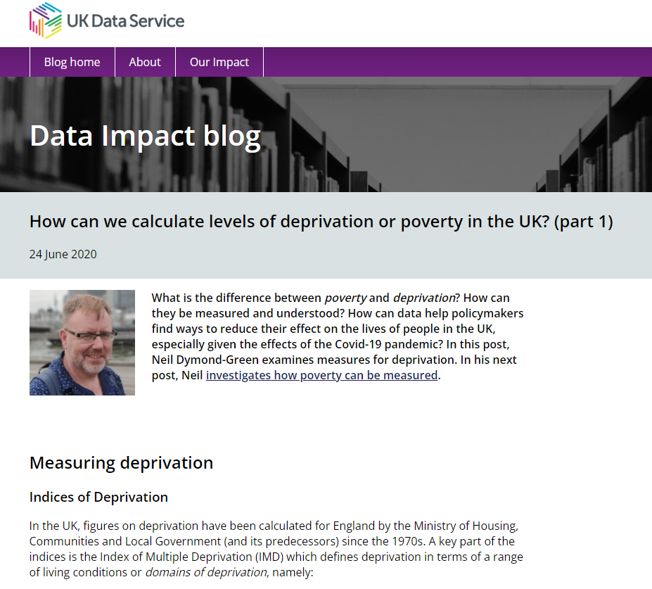
General measures of deprivation
Many surveys also contain general measures of deprivation such as the indices of multiple deprivation (IMD).
Some surveys that contain these variables include:
Crime survey for England and Wales
Millennium cohort study
Active Lives survey
Health Survey for England
National Survey of Sexual Attitudes and Lifestyles
Notes:
As well as studies that relate to relevant topics, many surveys also contain general measures of deprivation such as the indices of multiple deprivation (IMD).
Some surveys that contain these variables include [read off slide].
This can be really useful if you're wanting to research deprivation alongside any of the other topics in these surveys or over time. For example, the active lives survey looks at exercise and the MCS follows individuals over the life course.
And if you’re interested in more about these different measures our impact director Neil Dymond Green has written a blog post all about this.

Slide 16
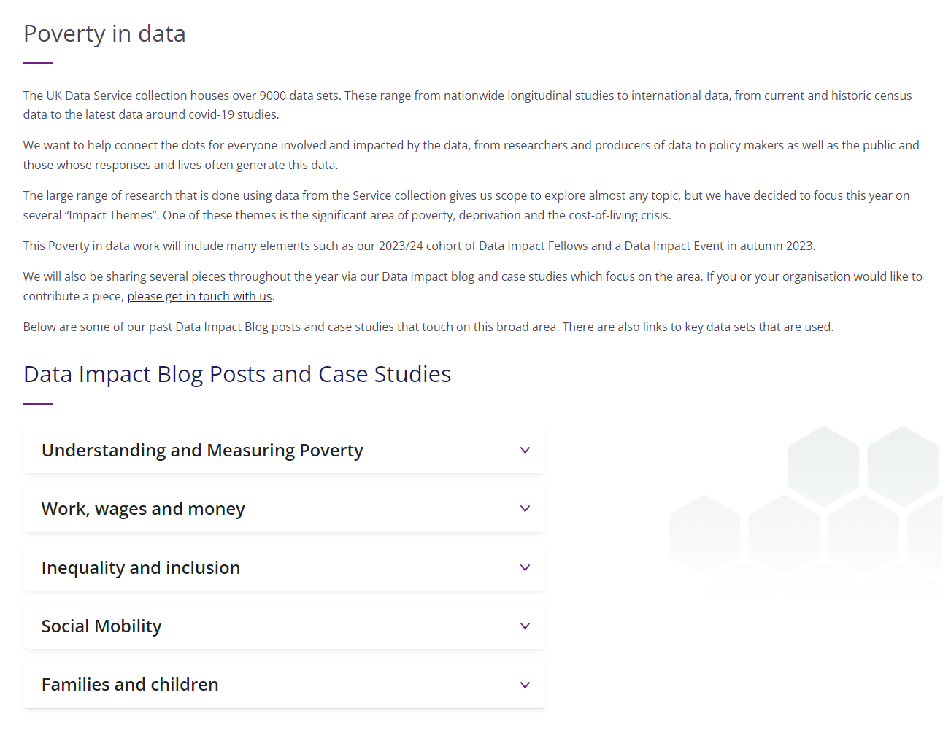
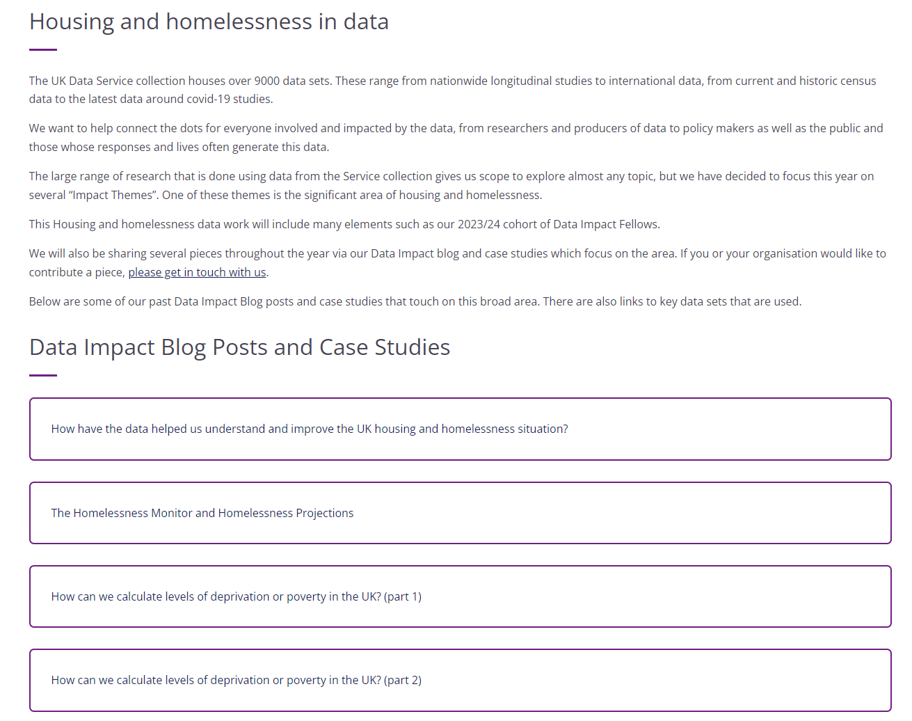
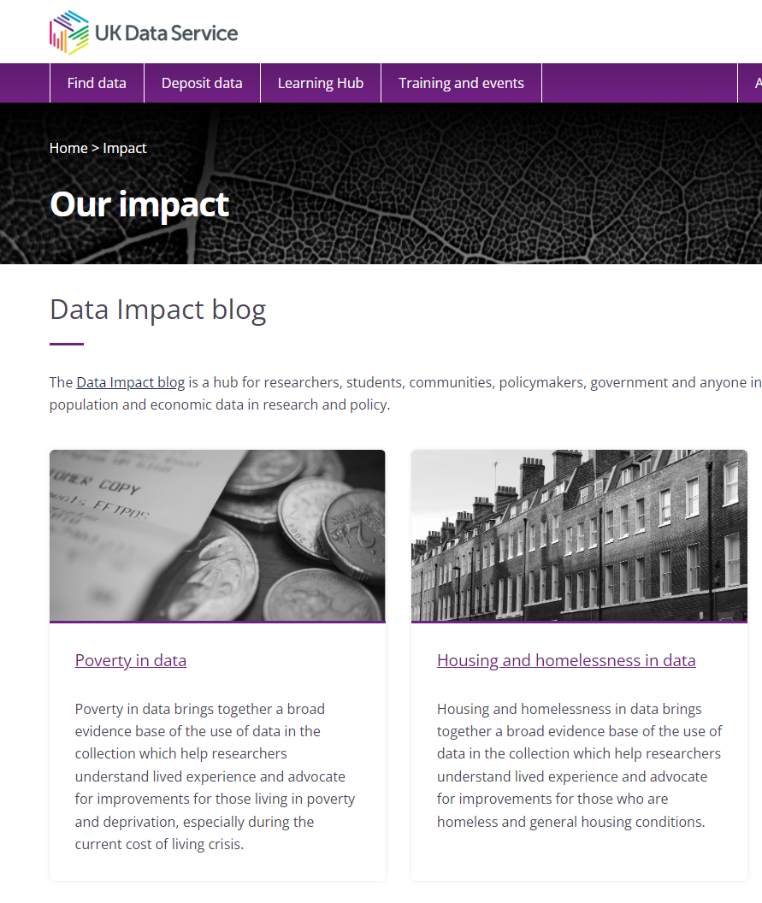
Data impact blog
Notes:
If you’re interested in examples of how these data have been used, the impact section of our website contains blogs and case-studies of how these data have been used. In particular, we have sections on poverty and housing and homelessness.

Slide 17
How to find and access data from the UKDS 1
Catalogue search tool
Notes:
So now I’ll just quickly cover how you can find and access all of these data from the UKDS.
The first place you can search is our catalogue search tool

Slide 18
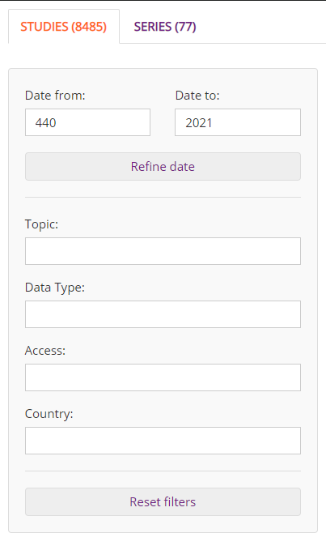
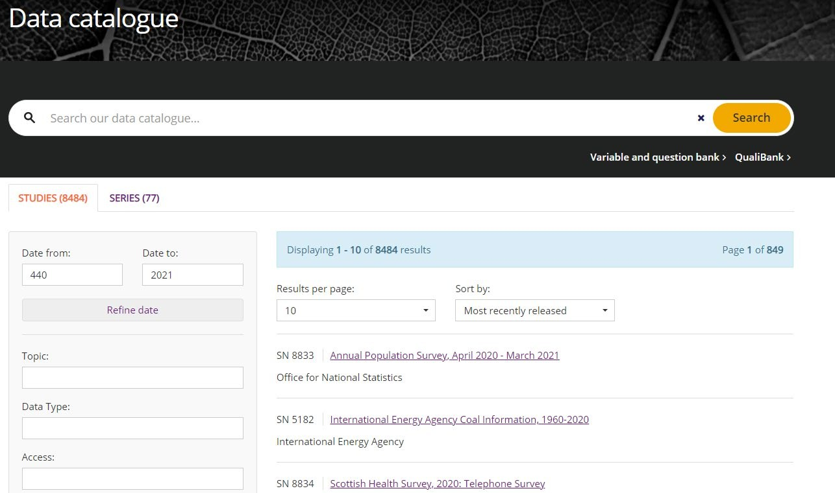
UKDS Catalogue page
Notes:
The catalogue search tool allows you to search the 7300+ datasets available from the UKDS. You can enter relevant search terms, search for particular datasets by name or study number. You can also use the filters down the left hand side to further refine your search.

Slide 19
How to find and access data from the UKDS 2
Catalogue search tool
Browse data pages
Theme
Data type
Teaching data
Notes:
Next up are our browse data pages.

Slide 20
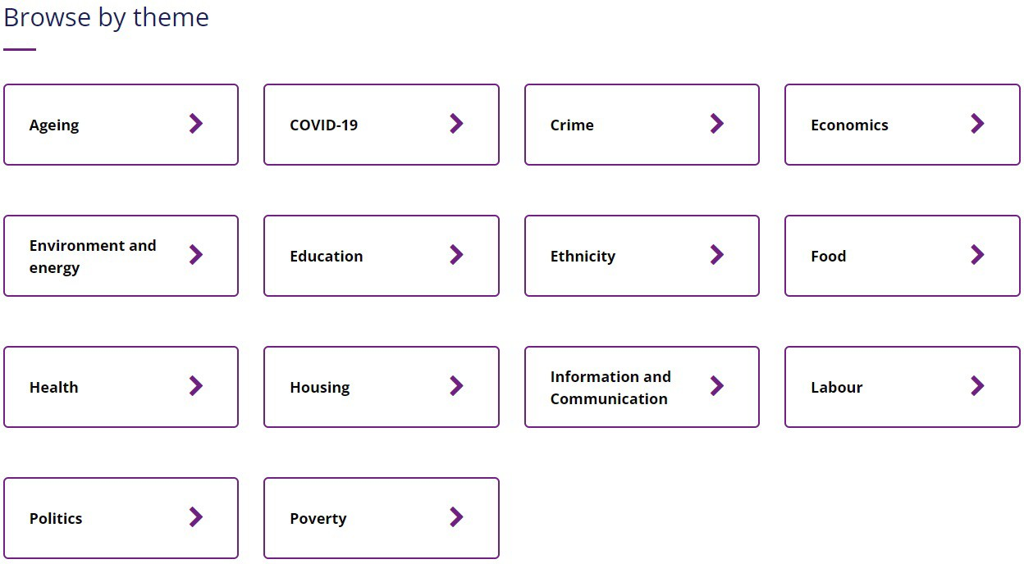
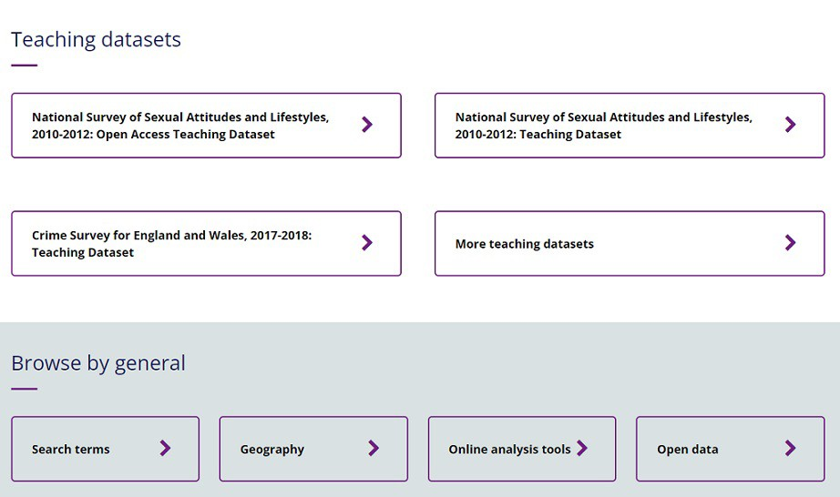
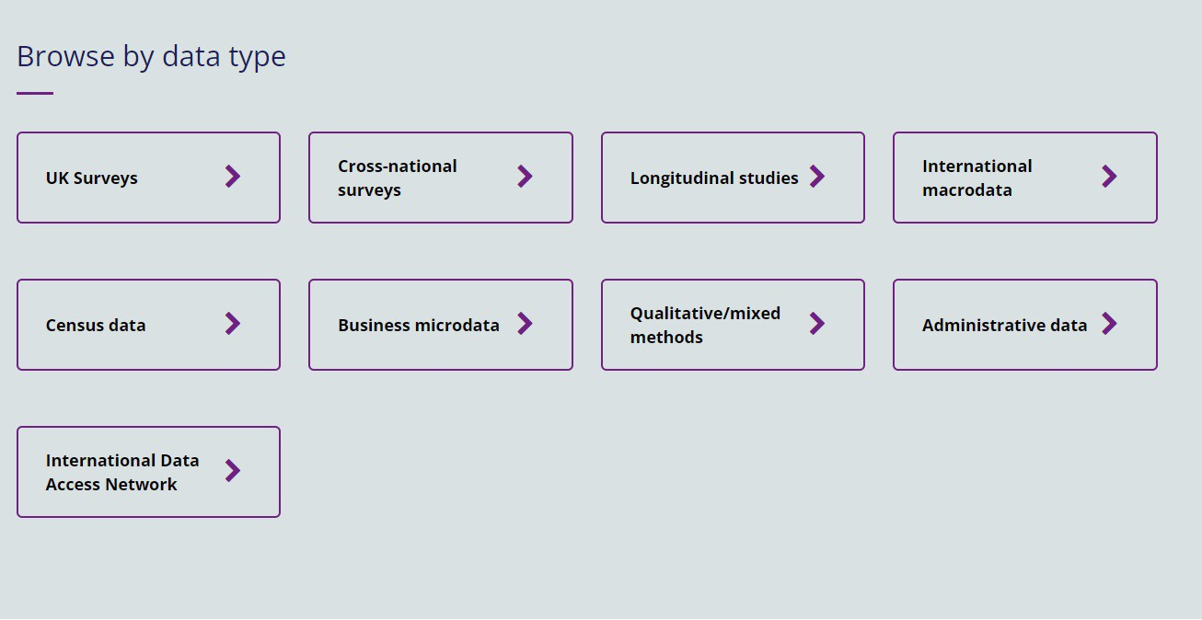
UKDS Browse data pages
Notes:
These pages allow you to browse by theme, or by particular data type, access further search tools and find datasets designed specifically for teaching.

Slide 21
How to find and access data from the UKDS 3
Catalogue search tool
Browse data pages
Theme
Data type
Teaching data
Variable and question bank
Notes:
You can also search for particular variables within datasets in our variable and question bank.

Slide 22
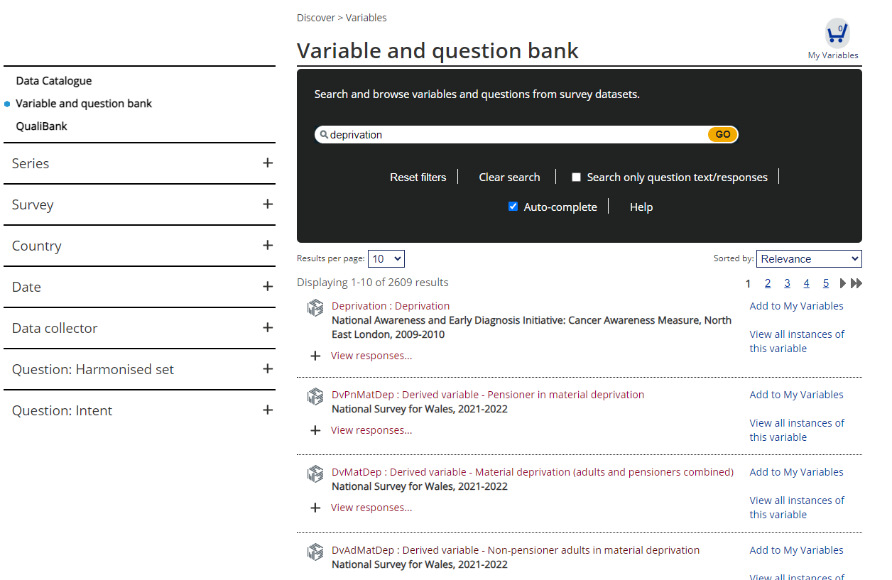
UKDS Variable and Question bank
Notes:
For example, if we type in ‘deprivation’ we can see which datasets contain variables on this topic. Just a note on the VAQB though, this doesn’t contain all of the datasets we currently hold, so it’s worth searching the catalogue for later versions of datasets to double check.

Slide 23
How to find and access data from the UKDS 4
Catalogue search tool
Browse data pages
Theme
Data type
Teaching data
Variable and question bank
Qualibank
Notes:
If you’re interested in Qualitative data, we also have our Qualibank.

Slide 24
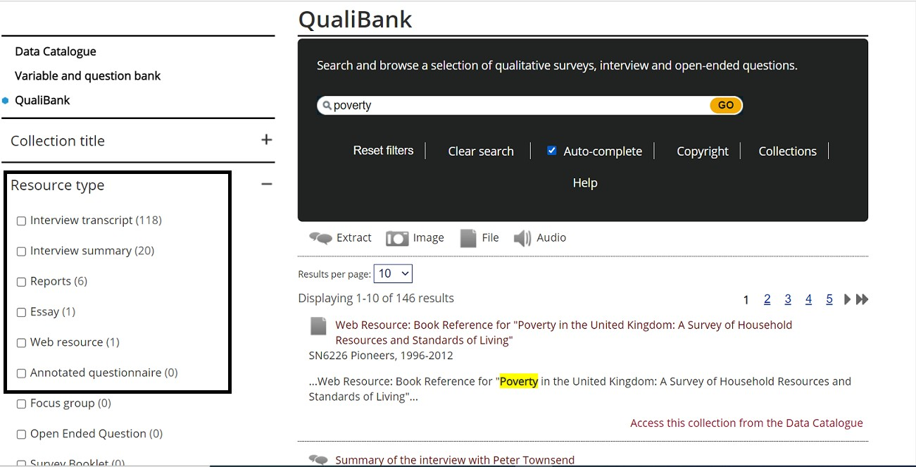
UKDS Qualibank
Notes:
This tool allows you to search within different types of qualitative resources for key terms.

Slide 25
How to find and access data from the UKDS 5
Catalogue search tool
Browse data pages
Theme
Data type
Teaching data
Variable and question bank
Qualibank
HASSET Thesaurus
Notes:
Finally, we have the HASSET thesaurus

Slide 26
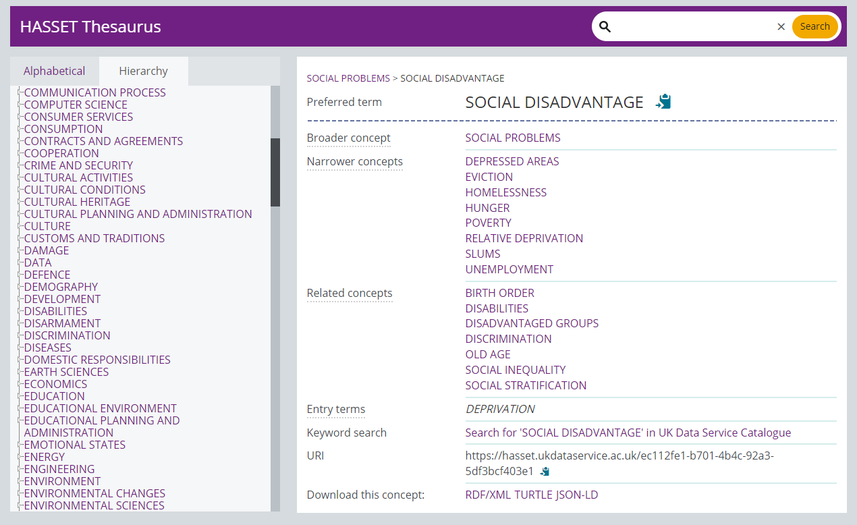
UKDS HASSET Thesaurus
Notes:
This search tool contains key social science terms and related concepts - for example here, deprivation is categorised under Social Disadvantage and you can conduct a search for this key term in the catalogue too.

Slide 27

Data Access Policy
Controlled data
Accessed via a Safe Room, SecureLab within the UK or the SafePod Network
Safeguarded data
End user licence (requires registration) and special licence (requires a form)
ReShare data
Access controls set by the data owner and can vary
Open data
Can be used by all without registering
Notes:
And just a quick point on the different data access levels.
So we have controlled data, also called secure access data, one of the most restricted types, which can only be accessed through a Safe Room, SecureLab within the UK or the SafePod network.
Safeguarded data which is EUL and requires registration, and also under this we have special licence data which has additional requirements. There’s also ReShare data, which is self-depositied access controls vary.
And then open data, which I mentioned earlier can be accessed by anyone without the need to register.

Slide 28
How to register
Logging in via OpenAthens or Shibboleth
UK Universities
Some further education colleges
Some UK Government departments
Local authorities
UK Data Archive username
International researchers
Charities
Think tanks
Schools
Personal researchers
Commercial organisations
Notes:
Finally, most of the data in our collections can be accessed free of charge, you simply need to register using your institutional log in. Or if you don’t have one, you can apply to get a UKDA username.

Slide 29
Thank you.
Alle Bloom
alle.bloom@manchester.ac.uk
Notes:
Thanks all for listening and let me know if you have any questions.

